Slide 1
Analysis of Glassdoor Reviews for competitors – Moody’s

Slide 2
Agenda
Executive Summary
Overall word cloud for Pros and Cons
What people liked (based on 5 star ratings)
What people liked (based on 4 star ratings)
What people liked (based on 3 star ratings)

Slide 3
Executive Summary
Objectives
Scrapping Glassdoor reviews for competitors given by their employees.
Analyzing reviews of competitors
Identify hidden patterns in data about employee engagement.
Key Observations
We scrapped more than to 98% of reviews.
Total 780 reviews were analyzed.

Slide 4
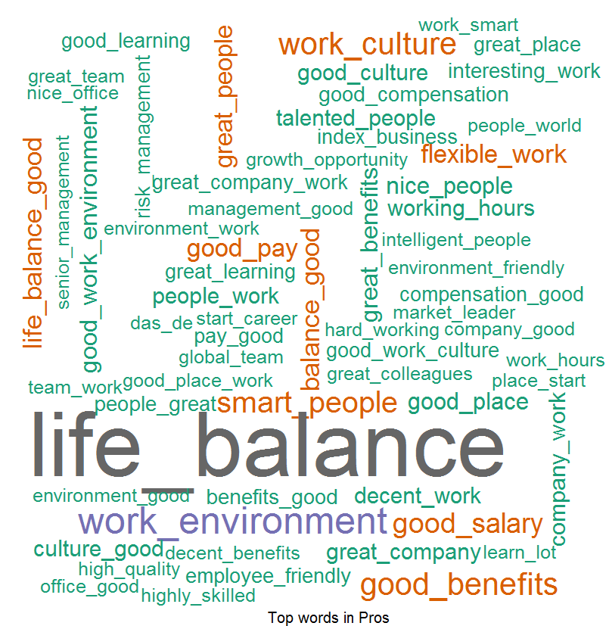
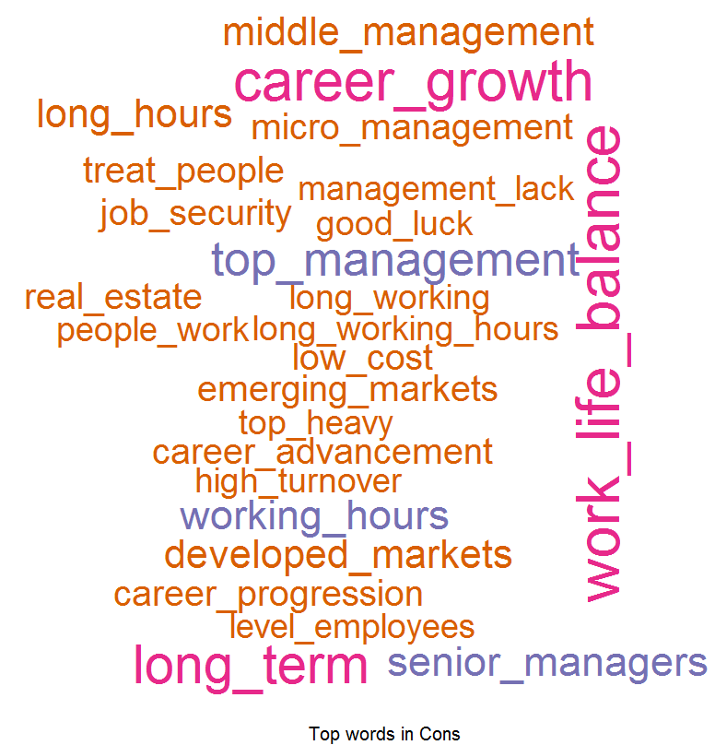
Overall Word Cloud for Pros and Cons
Word Cloud for Pros
Word Cloud for Cons
Good Words List –
Work life balance
Good work
Work environment
Good benefits
Work culture
Smart people
Word List which people don’t like –
Senior management
Cost Cutting
Career development
Work life balance
Career growth
High turnover
Work culture

Slide 5
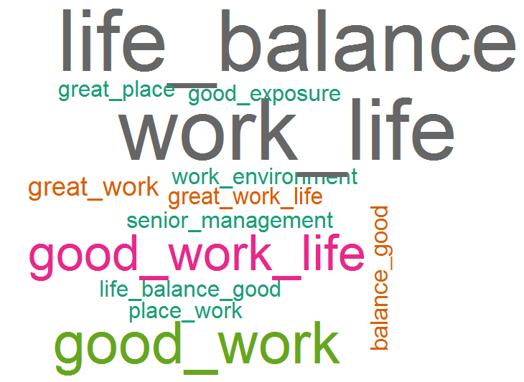
What people liked (based on 5 star ratings)
Word Cloud for Pros
Good Words List –
Work life balance
Good work
Work environment
Good salary
Good benefits
Smart people
Work culture
Index business

Slide 6
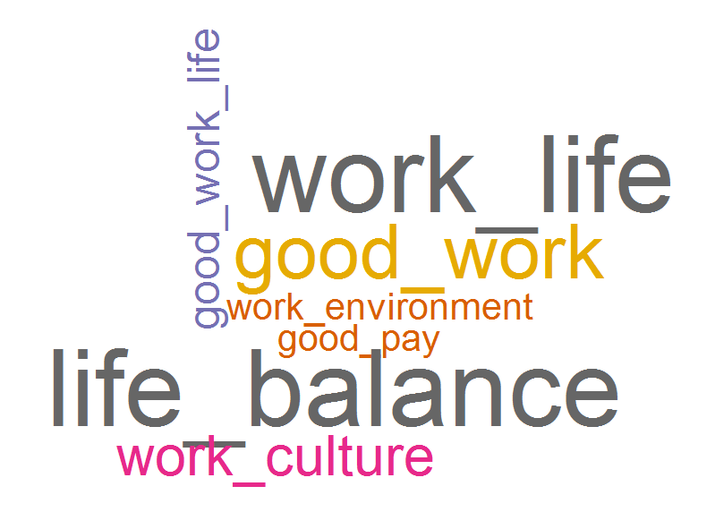
What people liked (based on 4 star ratings)
Word Cloud for Pros
Good Words List –
Work life balance
Good work
Work culture
Good pay
Work environment

Slide 7
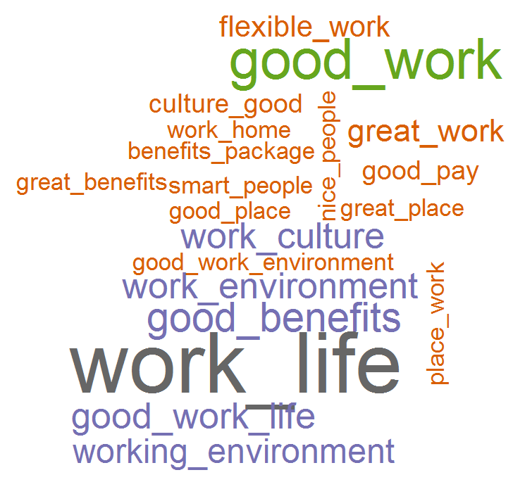
What people liked (based on 3 star ratings)
Word Cloud for Pros
Good Words List –
Work life balance
Good work
Good benefits
Work environment
Work environment
Work culture
Flexible work
Good pay
Work from home
Nice / smart people

